Slide 1
The purpose of the FA Coach Mentor programme:
Improve coaching in grassroots football.
Up-skill and support coaches to develop knowledge, confidence, and delivery skills.
Bring the England DNA to life in grassroots clubs.
Improve match day behaviours of all stakeholders
Retain coaches in the game.
Retain players in the game.
Support individual coach learning.
Cascade the network of mentors and leave a ‘legacy’.
Leave League with a Coaching and Playing Philosophy

Slide 2
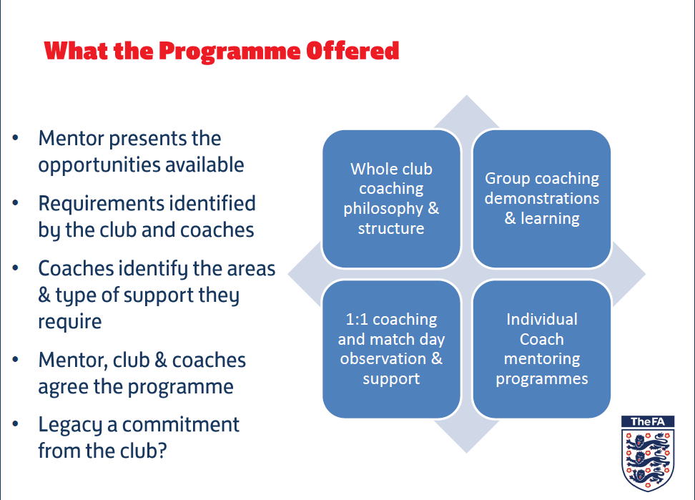
THE PROGRAM
IS FREE TO ALL
CLUBS !!!
FA Coach mentoring on the ground

Slide 3


Slide 4
The benefits of the programme to COACHES/CLUB:
Empowering the coach
Observation and support of sessions.
Training and match-day support and feedback.
Individual action plans – learning programmes.
Support for developing players across the ‘four corners’.
Support for structuring sessions to meet the needs/expectations of different players.
Signposting to relevant support
Support for the wider league/club – philosophy etc.

Slide 5



The most important thing is…..
We all have FUN!
The most important thing is…
We all have fun, learn and enjoy ourselves!

Slide 6
Jon Simmons| FA Coach Mentor
T: 01189-788814
M: 07748-652899
Jonathan.Simmons@TheFA.com

